Slide 1
A Healthy Workplace
An ALL In Holistic view of one approach
Michael Georgie – Facility Project Manager, Brampton Library

Slide 2
Agenda
What is a healthy workplace?
Springdale Library and Neighborhood Park
Functional Plan
PreDesign and Design
Construction
How to integrate in your projects
Questions

Slide 3
Healthy Workplace
CCOHS describes a healthy workplace as:
There is a strong connection between the health and well being of people and their work environments. When people feel valued, respected and satisfied in their jobs and work in safe, healthy environments, they are more likely to be more productive and committed to their work. Everyone can benefit from a healthy workplace. (Canadian Centre for Occupational Health & Safety)
https://carleton.ca/healthy-workplace/
http://healthyworkplacemonth.ca/en/

Slide 4
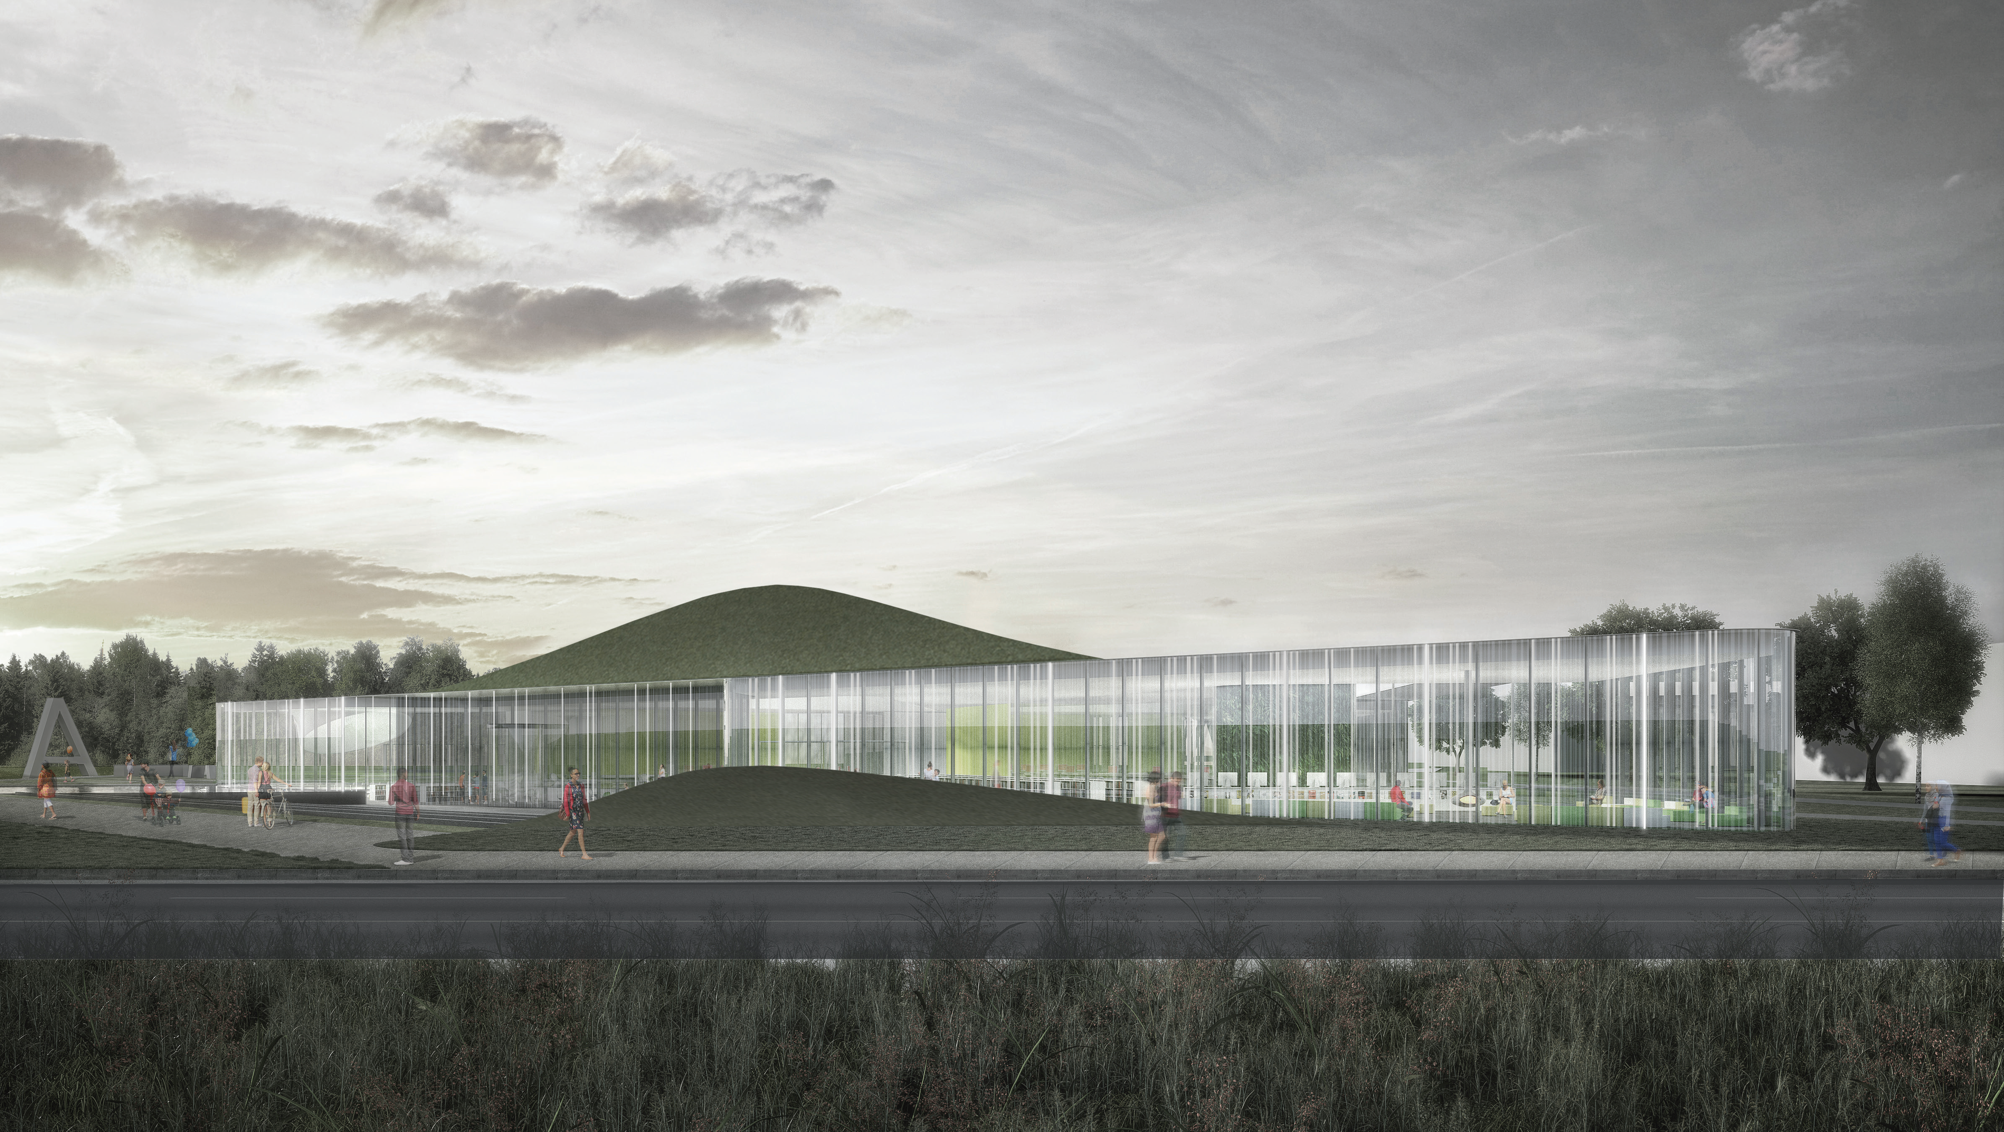

Slide 5
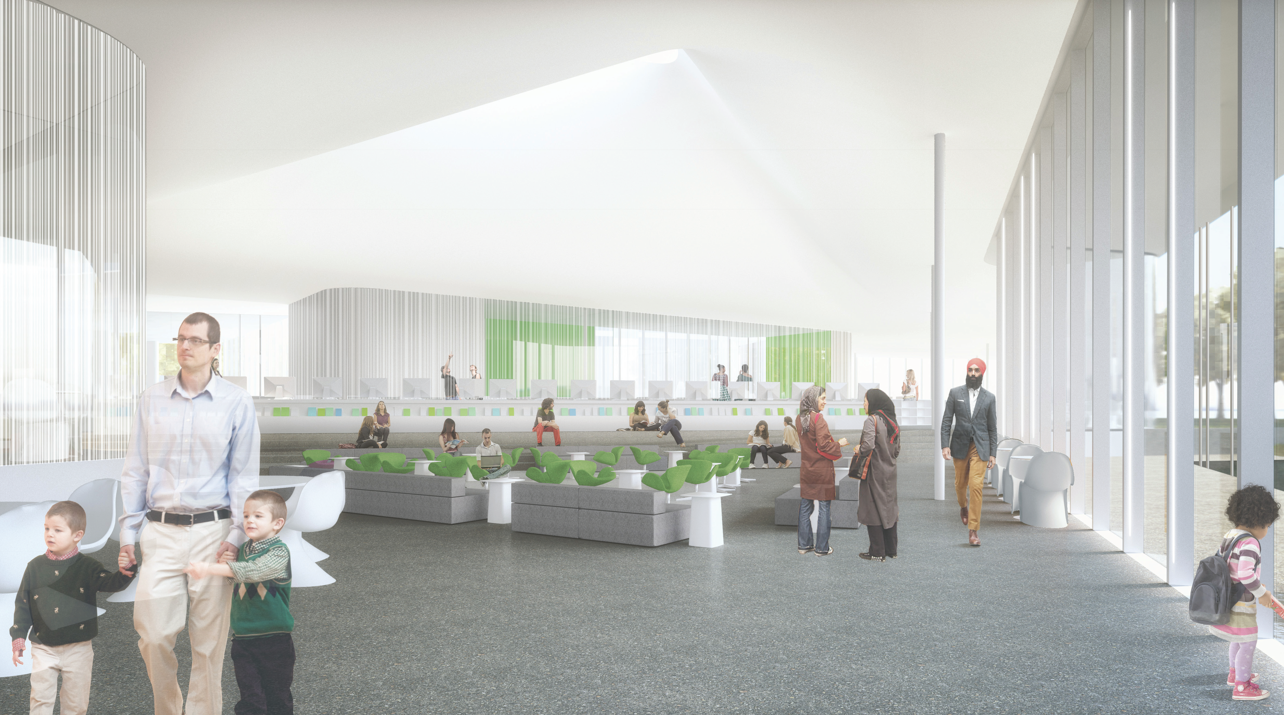

Slide 6
Building a new Library Branch
Functional Plan
Breakdown of all areas of a branch
PreDesign and Design
Decisions/Changes/Compromise
Construction
LEED

Slide 7
FUNCTIONAL AREAS
Functional Area | Sq. Footage | Sq. Footage | Sq. Footage | Notes
Collection | 9,000 | 11,000 | 15,000 | Collection (books, DVD’s, periodicals, browsing)
Study Space individual | 3,600 | 4,150 | 5,000 | Soft seating, tables/chairs, literacy stations, teen seating
Study Space groups | 900 | 1,100 | 1,800 | For groups of more than four
Customer Service Area | 1,000 | 1,000 | 1,000 | Holds, self check-out, customer service desk
Program Space | 0 | 1,500 | 2,000 | Community Meeting Room
Staff Work Area | 2,500 | 2,500 | 2,500 | Office, storage, lunch room, sortation, processing, work tables
TOTAL | 17,000 | 21,250 | 25,500
Plus 15% unassigned space | 3,000 | 3,750 | 4,500 | mechanical, washrooms, janitorial/waste storage
GRAND TOTAL | 20,000 | 25,000 | 30,000

Slide 8
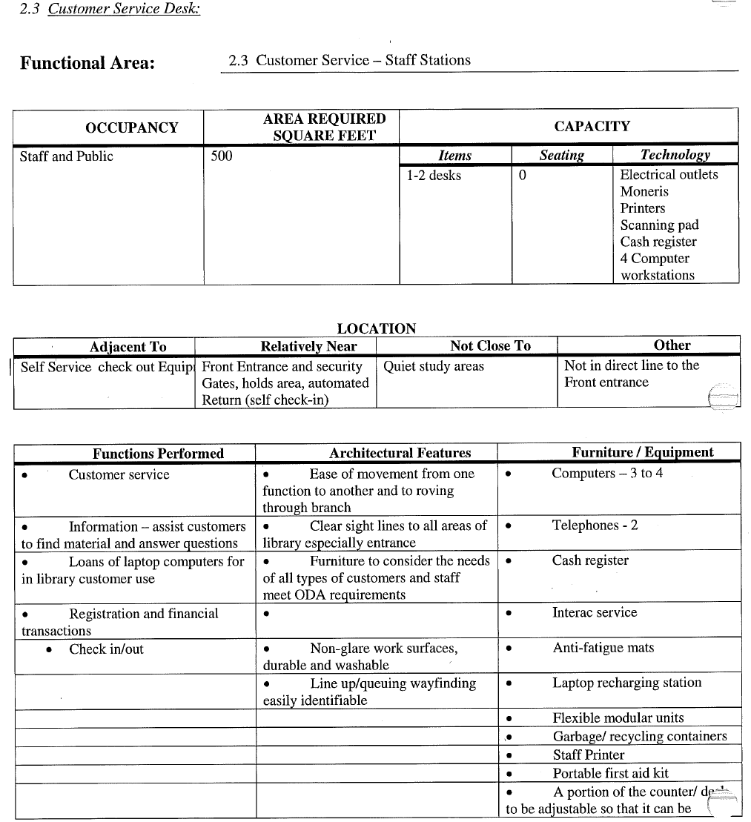

Slide 9
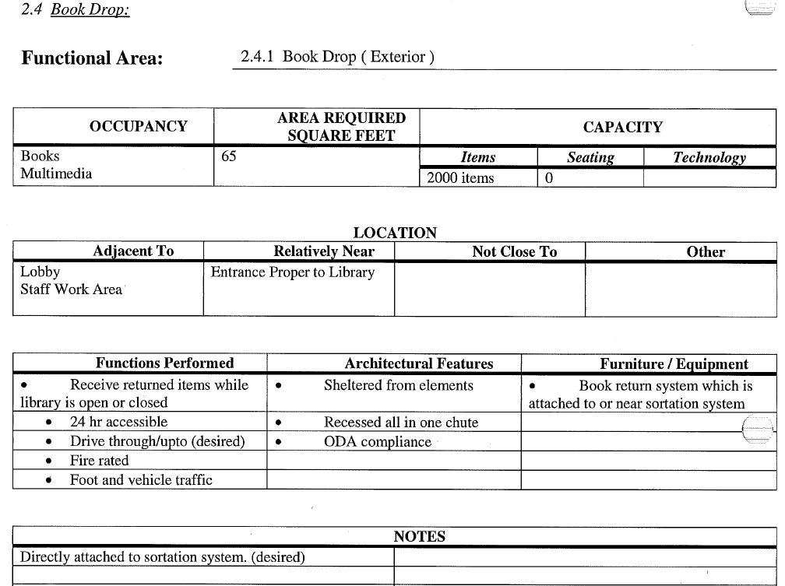

Slide 10
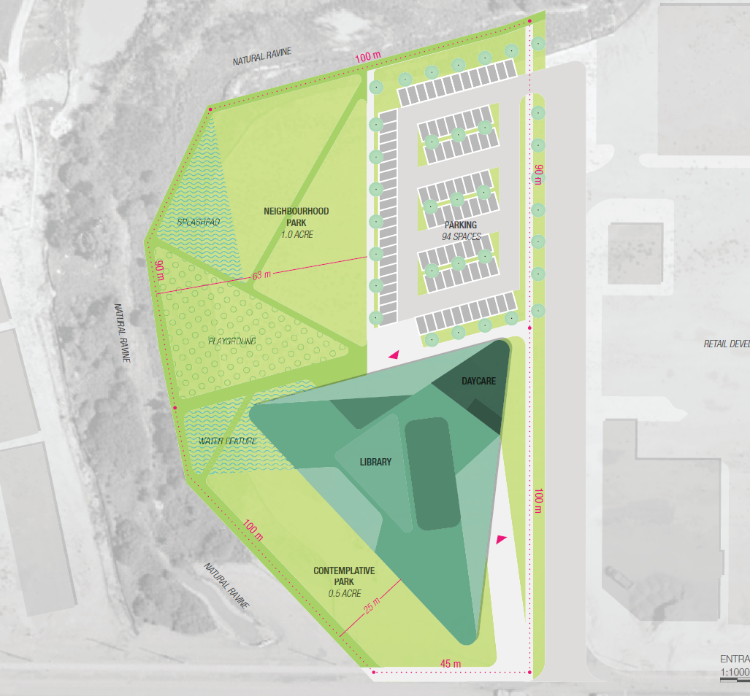

Slide 11
LEED
www.cagbc.ca
Leadership in Energy and Environmental Design® (LEED) is a rating system that is recognized as the international mark of excellence for green building in over 160 countries. Since 2002, the Canada Green Building Council® (CaGBC) and LEED Canada have been redefining the buildings and communities where Canadians live, work and learn.
LEED works because it recognizes that sustainability should be at the heart of all buildings – in their design, construction and operation. Since 2004, the CaGBC has certified over 2,800 LEED buildings in Canada and registered over 5,000 – with the second highest number of LEED projects anywhere in the world.
Green buildings create a healthier indoor environment for occupants through better indoor air quality, less harmful products, and more natural daylight. They also reduce waste, conserve energy, decrease water consumption, and drive innovation. All of this can positively affect your bottom line and boost productivity.

Slide 12
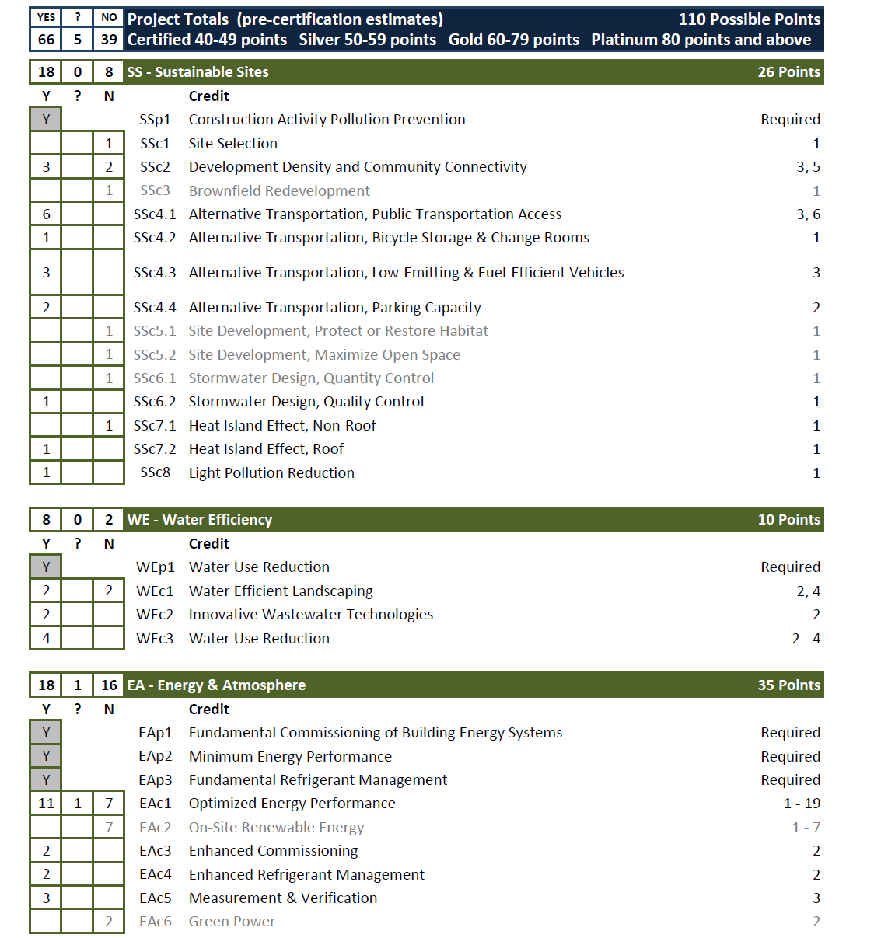

Slide 13
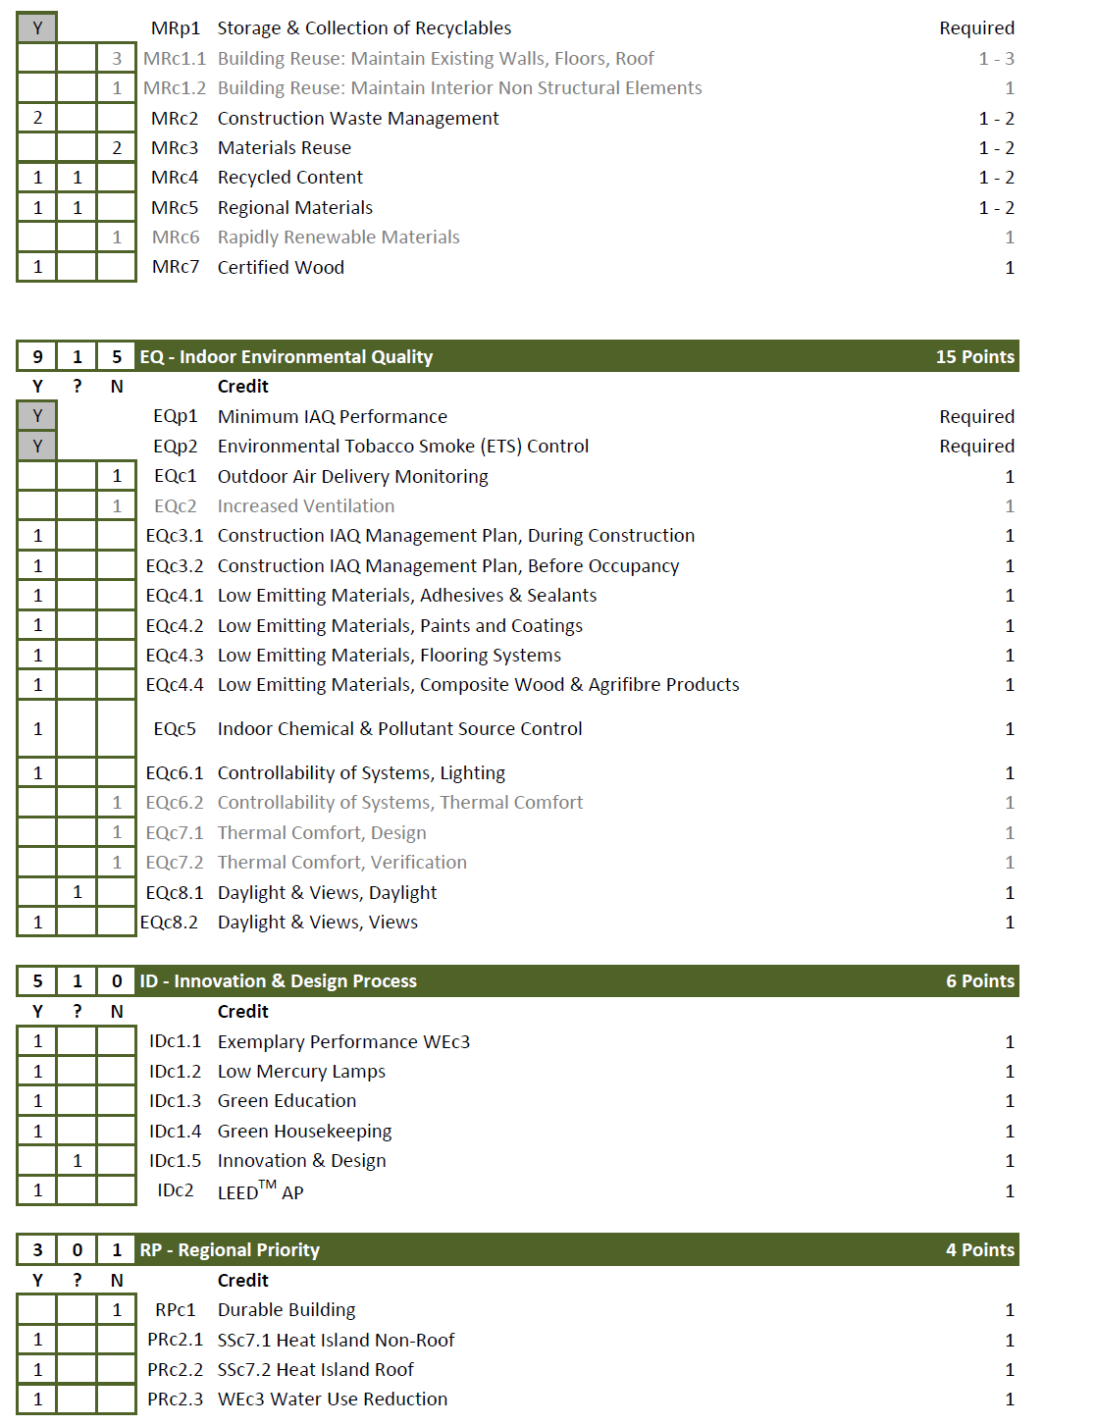

Slide 14
GreenGuard
www.greenguard.org
UL Environment's GREENGUARD Certification program helps manufacturers create--and helps buyers identify and trust--interior products and materials that have low chemical emissions, improving the quality of the air in which the products are used. All certified products must meet stringent emissions standards based on established chemical exposure criteria.

Slide 15
How to integrate in your projects?
IAQ (indoor air quality)
Green guard paint/furniture/flooring, upgrade hvac
Electricity
Led lighting (in & outdoors), room sensors, change flourescent bulbs from T12 to T8, connect lighting to BAS (Building Automation System), generation (solar panel, windmill)
Water (indoors)
Hands free fixtures, grey water system
Water (outdoors)
Storm water management (green roof, bioswale)
Environment
Carpool spots, electric vehicle charging, reduce light pollution, environmentally friendly cleaning supplies,

